Slide 1








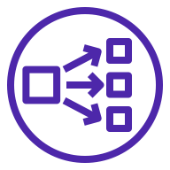






AWS Cloud
Region
Amazon Route 53
VPC
Availability Zone 1
Availability Zone 2
Public subnet
Public subnet
Internet gateway
NAT gateway
NAT gateway
AWS Certificate Manager
Network Load Balancer
Private subnet
Private subnet
Auto Scaling group
Amazon S3
Fargate Containers
Fargate Containers
Amazon ECR
EFS

